Slide 1
Lifeshades
Photography
4867 - Sohan Chavan
4848 - Prashant Ghadge

Slide 2
INTRODUCTION:
Lifeshades Photography project a system which help the users to login and make a reservation for photo-shoot & video-shoot (includes pre-wedding, wedding, baby-shower, birthday, food, maternity,model shoot, etc). Customers can view packages according to there event/venue functions. Payment can be made online/offline as per user choices. Users can directly contact with admin for any query or more details.

Slide 3
OBJECTIVES:
The function of a photographic objective is to image light from more or less distant objects to some image plane, where either a photographic film or an electronic image sensor is placed. ... Even multi-lens objectives are often called photographic lenses. Objectives To understand the basic techniques of photography. To compare traditional film and digital cameras and photography.To analyze the various equipment which can enhance photography.To create a quality photograph using basic rules and technology.To discuss the impact of photography in publications. Chapter Links The Camera Film vs. Digital Equipment, Accessories & Necessities What Makes a Good Photograph

Slide 4
NEED FOR SYSTEM:
Lifeshades Photography involves Photography, creation and development of different Order , like a parties , includes pre-wedding, wedding, baby-shower, birthday, food, maternity, model shoot, etc. Lifeshades Photography a career is a multi faceted activity .

Slide 5
Scope :
Photography - Career Scope & Job Prospects This career role demands an ability to photograph all kinds of newsworthy people, places, sports, political, and community events for newspapers, journals, magazines, or television. A photojournalist must possess a journalistic sense to shoot a good news picture.

Slide 6
HARDWARE AND SOFTWARE REQUIREMENTS:
HARD DISC: 160 GB RAM: 256 MB RAM PROCESSOR: Intel core Processor PROCESSOP SPEED :1.60 GHz.
The software requirements are: Frontend/language – HTML Database – PHP/MySQL Additional Tools – XAMPP Operating Sytem - Windows

Slide 7
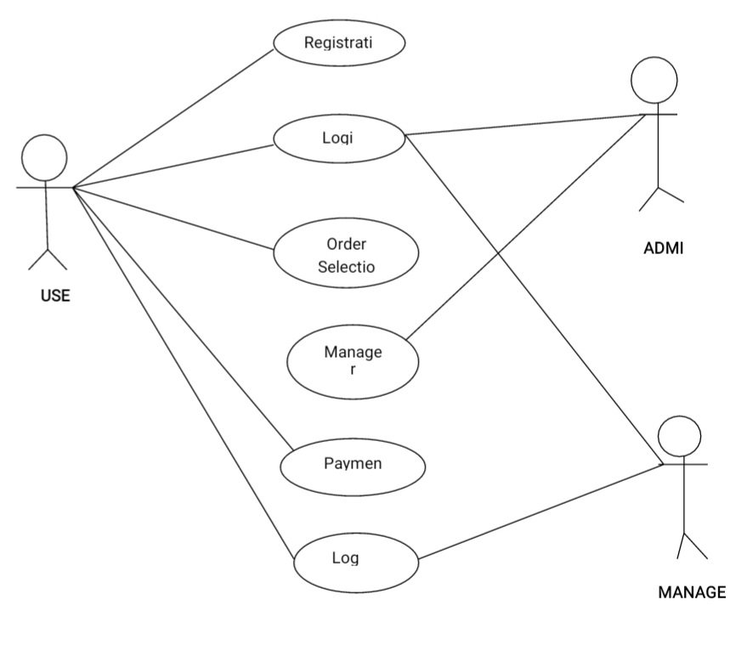
USE CASE DIAGRAM:

Slide 8
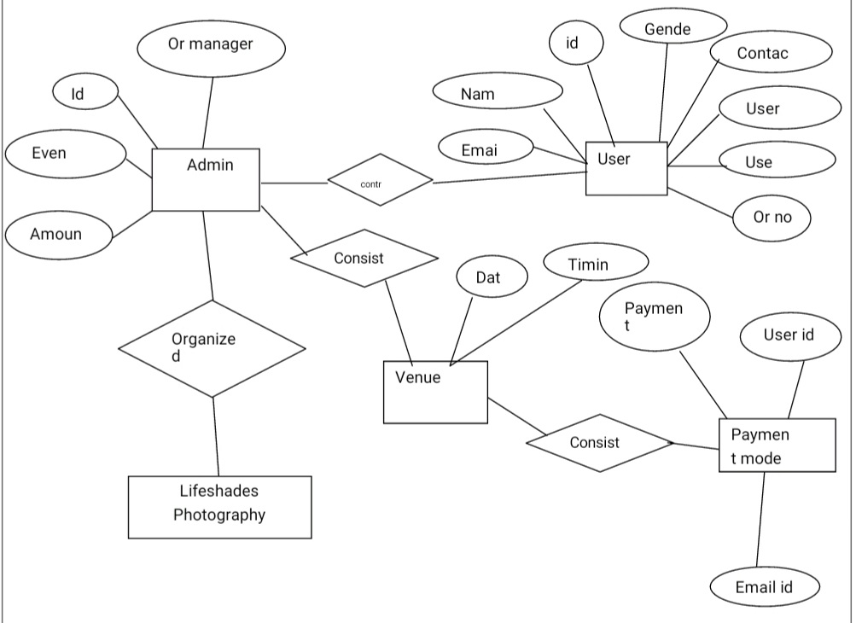
ER DIAGRAM:

Slide 9
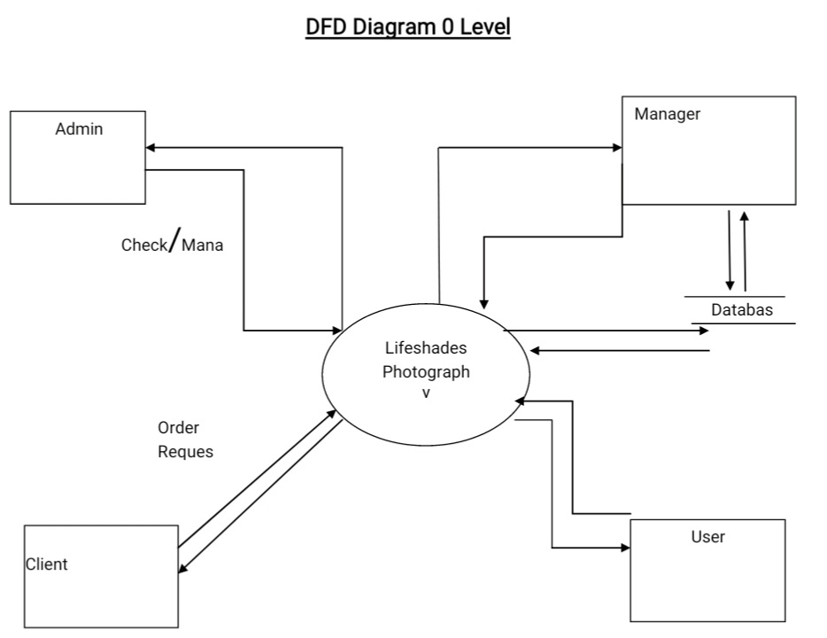
CONTEXT LEVEL DFD:

Slide 10
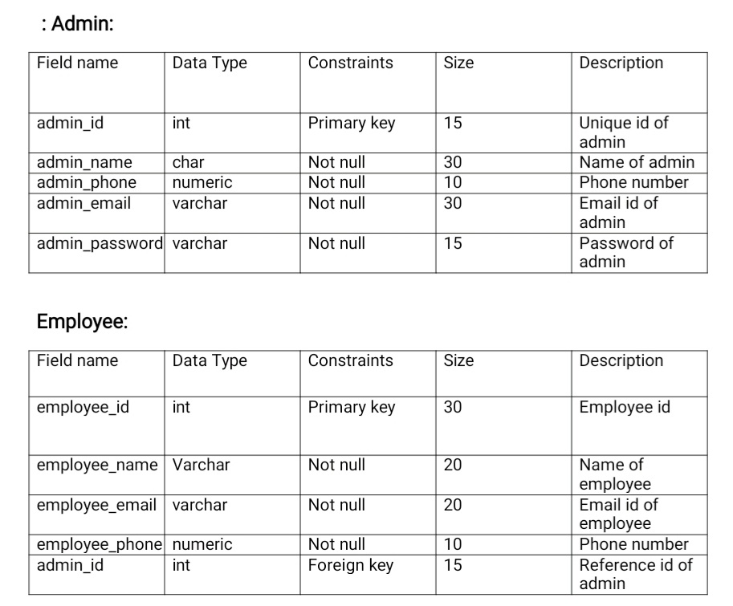
DATA DICTIONARY

Slide 11
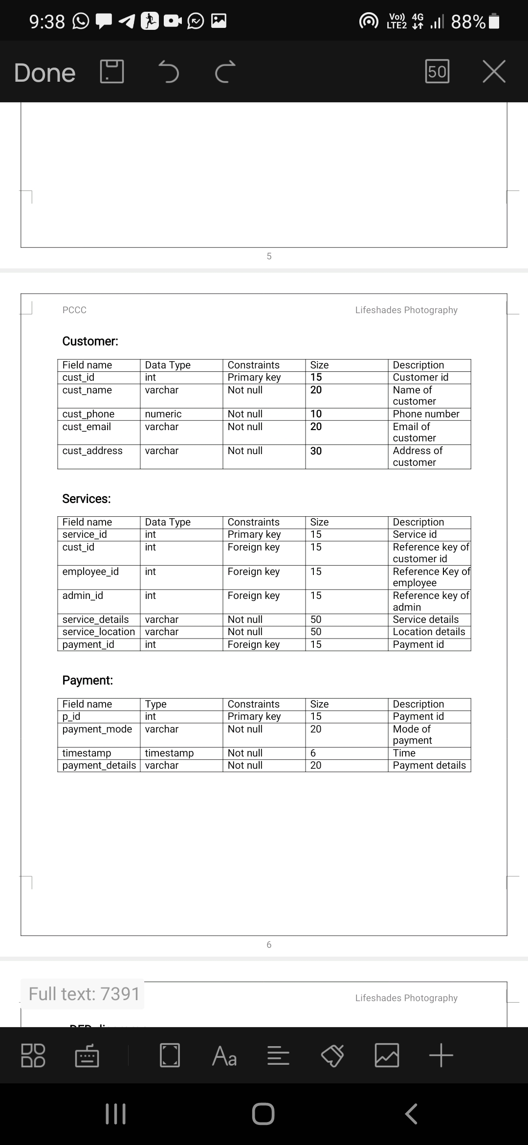

Slide 12
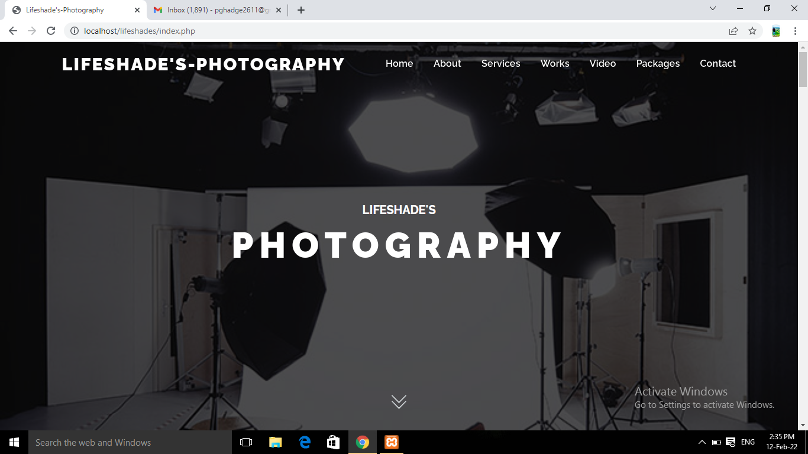
Input Screen
MainScreen:

Slide 13
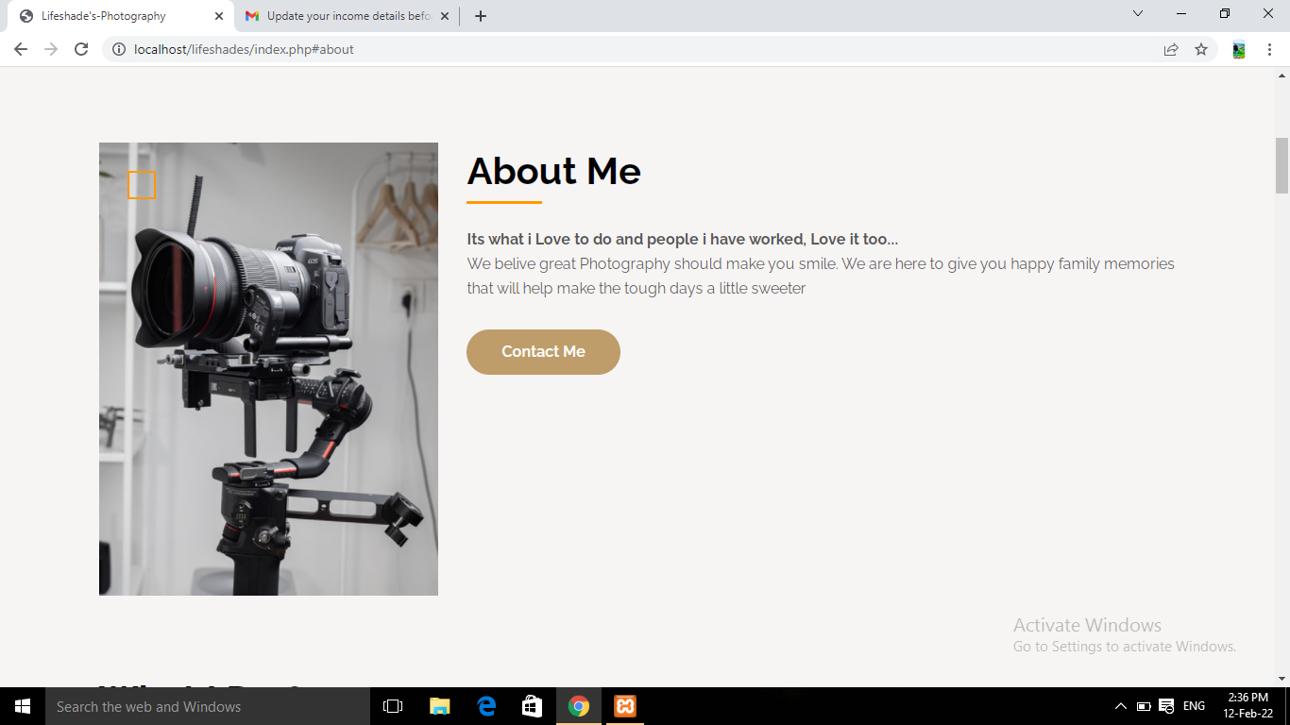
About page:

Slide 14
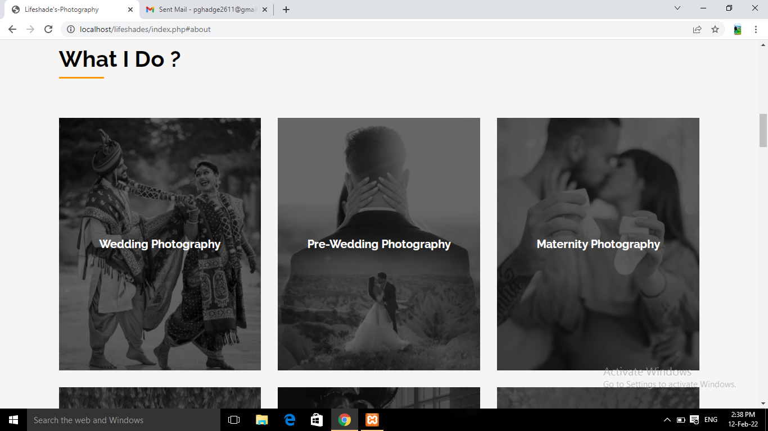
What I do page:

Slide 15
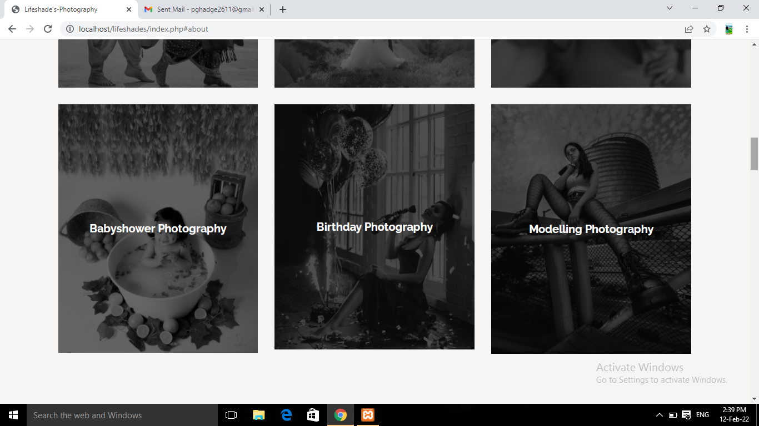

Slide 16
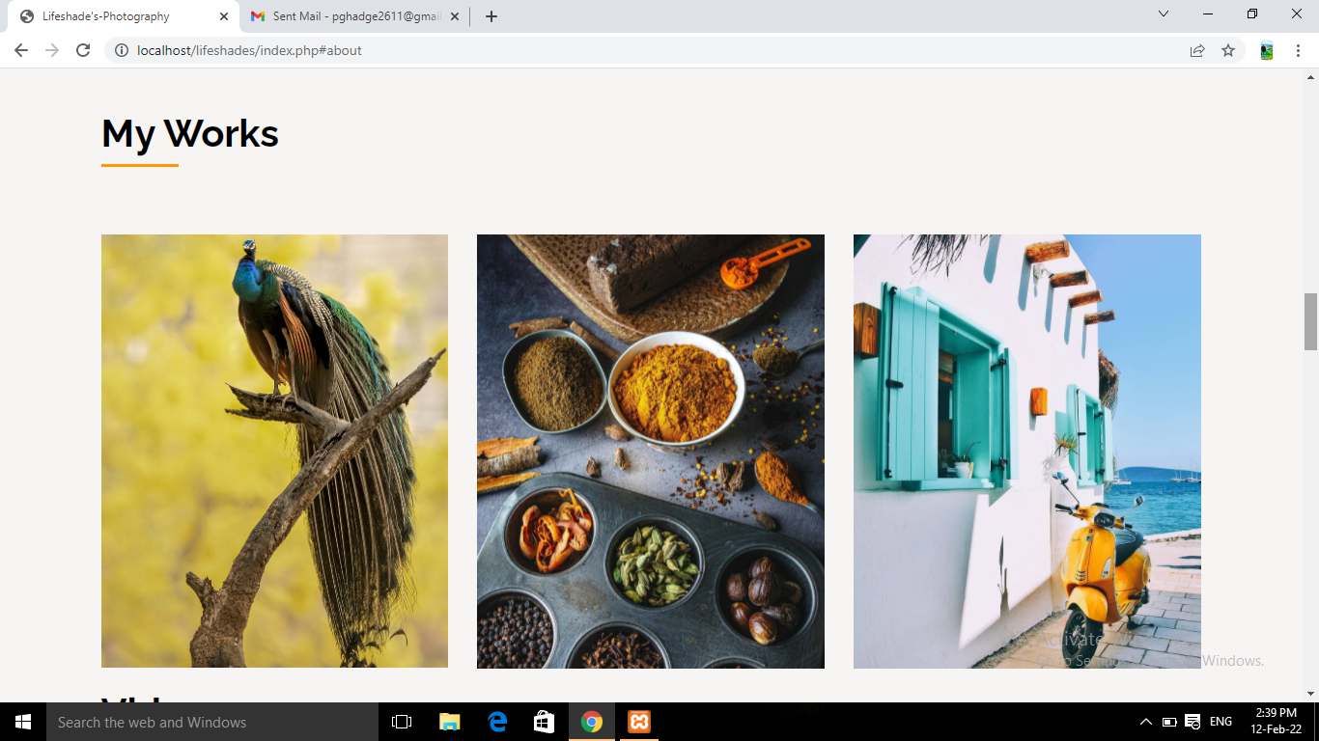
My Work:

Slide 17
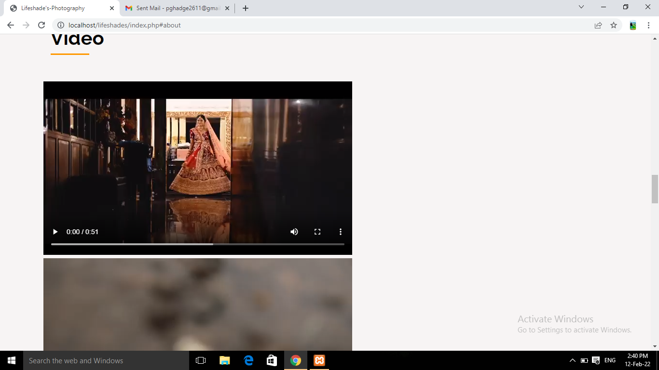
Videos :

Slide 18
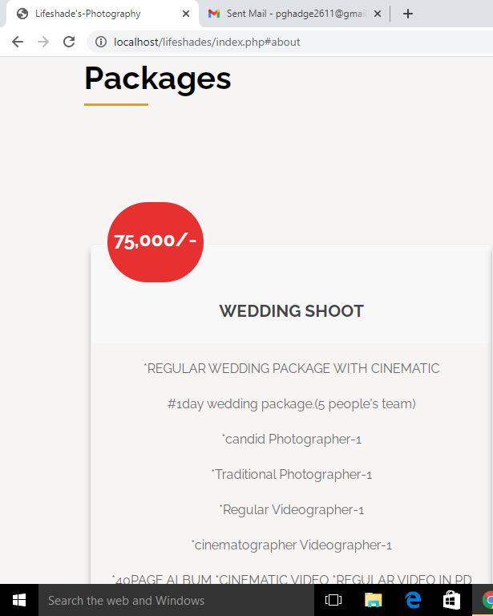
Packages :

Slide 19
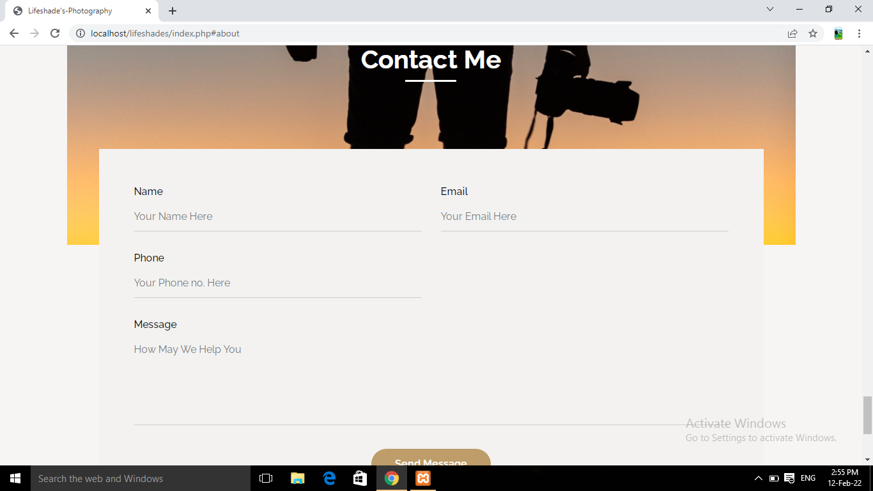
Contact Page :

Slide 20
Conclusion
The System was designed in such a way that future modifications can be done easily. System security, data security and reliability are the striking features Updating and deleting of information becomes so easier. • The System has adequate scope for modification in future if it is necessary.

Slide 21
Future Enhancement:
The System has adequate scope for modification in future if it is necessary. Give a facility to send a text message or email to the customer regarding their request to our system (accepted or rejected) Include internet banking Create a receipt of the amount paid.

Slide 22
Google for problem solving.
Wikipedia.com
Phptpoint.com
https://phpgurukul.com/event management-system-using-php-and-mysql/
.➢https://phpgurukul.com/tag/online-event-management-saystem

Slide 23
THANK YOU

